Slide 1
COMPUTER GRAPHICS
Parallel &
Perspective Projections
From 3D World to 2D Screen: Mathematical Foundations of Projection
Computer Graphics | 3D Rendering Pipeline | Projection Mathematics

Slide 2
Table of Contents
01
What is Projection?
Concept & need for 3D→2D transformation in graphics
02
Parallel Projection
Orthographic & oblique: principles and math formulas
03
Perspective Projection
COP, vanishing points, and mathematical derivation
04
Projection Matrices
OpenGL glOrtho / glFrustum / gluPerspective deep-dive
05
Comparison & Applications
Key differences, use cases, and rendering pipeline

Slide 3
01 What is Projection?
Definition: The process of mapping 3D objects onto a 2D plane (the screen).
Mathematically, it is a linear transformation from a higher to a lower dimension.
Why Do We Need It?
Types of Projection
• Monitors/screens are 2D surfaces • 3D scenes cannot be displayed directly • Depth info (z) must be encoded in 2D • Core step in every rendering pipeline
Projection
Parallel
Perspective
Ortho / Oblique
1pt / 2pt / 3pt VP

Slide 4
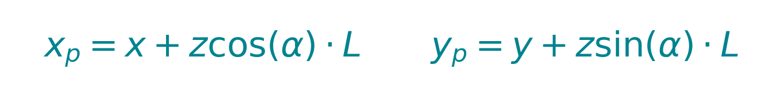
02 Parallel Projection
Projectors are parallel → Center of Projection (COP) is at infinity.
Object size remains constant regardless of distance from viewer (size invariance).
① Orthographic Projection
② Oblique Projection
Projectors are perpendicular (90°) to the projection plane.
Used in engineering drawings, floor plans, blueprints.
Projectors hit the plane at an angle (≠90°).
Cabinet (L=0.5) and Cavalier (L=1) are common types.
3D
Object
2D
Result
where α = angle, L = foreshortening factor
3D
Object
2D
Result
Projection
Plane

Slide 5
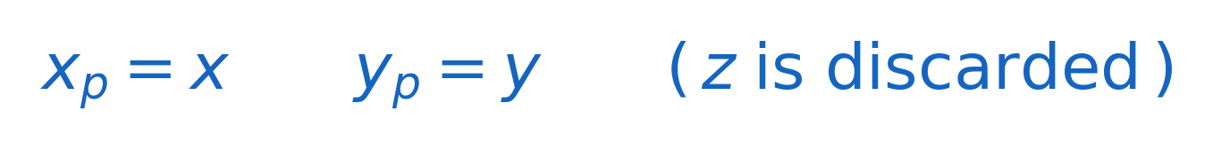
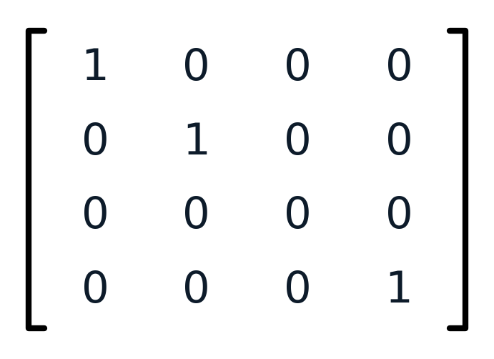
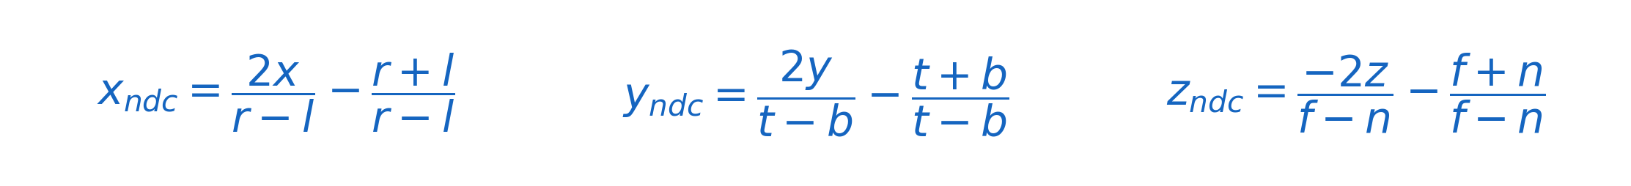
Orthographic Projection — Mathematics
Basic Formula (XY Plane Projection)
The z-coordinate is simply dropped → depth information is lost
4×4 Matrix Form
NDC Mapping (glOrtho)
Maps view volume (Cuboid) → Normalized Device Coordinates [-1, 1]³
l=left, r=right, b=bottom, t=top, n=near, f=far

Slide 6
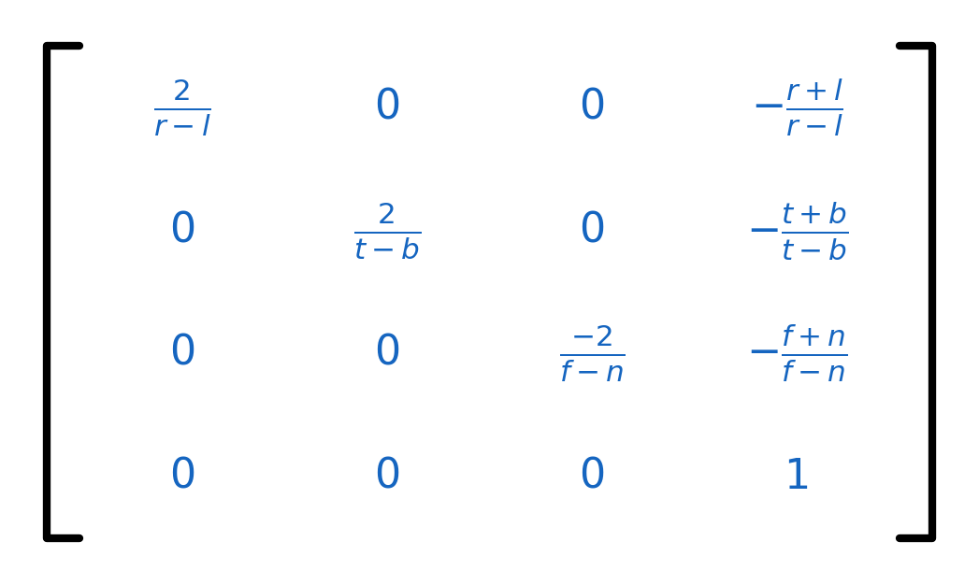
glOrtho — Full Projection Matrix
glOrtho(l, r, b, t, n, f)
What Each Part Does
Row 1
2/(r−l)
Scale x to fit [-1,1]
Row 2
2/(t−b)
Scale y to fit [-1,1]
Row 3
−2/(f−n)
Scale z to fit [-1,1]
Col 4
Translations
Shift centre of cuboid
to NDC origin (0,0,0)
Row 4
[0,0,0,1]
No perspective divide;
linear transformation only

Slide 7
03 Perspective Projection
All projectors converge at a single point — Center of Projection (COP).
Objects appear smaller as distance increases → mimics the human eye.
Types of Perspective Projection (by Vanishing Points)
1-Point Perspective
2-Point Perspective
3-Point Perspective
1 vanishing point
Viewer faces a surface directly
Railways, corridors, tunnels
2 vanishing points
Viewer at a corner/edge
Building exteriors, architecture
3 vanishing points
Looking up or down steeply
Aerial views, worm's-eye views

Slide 8

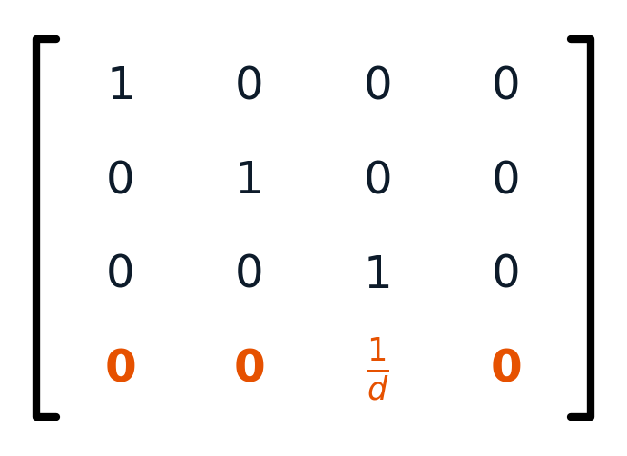

Perspective Projection — Mathematical Derivation
Derivation: Similar Triangles (Pinhole Camera Model)
COP at origin, projection plane at z = d:
As z increases (object moves away), xp and yp shrink → perspective foreshortening!
Homogeneous Coordinates
View Volume: Frustum
• Shape: Truncated pyramid • Near plane (n): closest visible • Far plane (f): farthest visible • Field of View (FoV): cone angle • Aspect Ratio: width / height

Slide 9
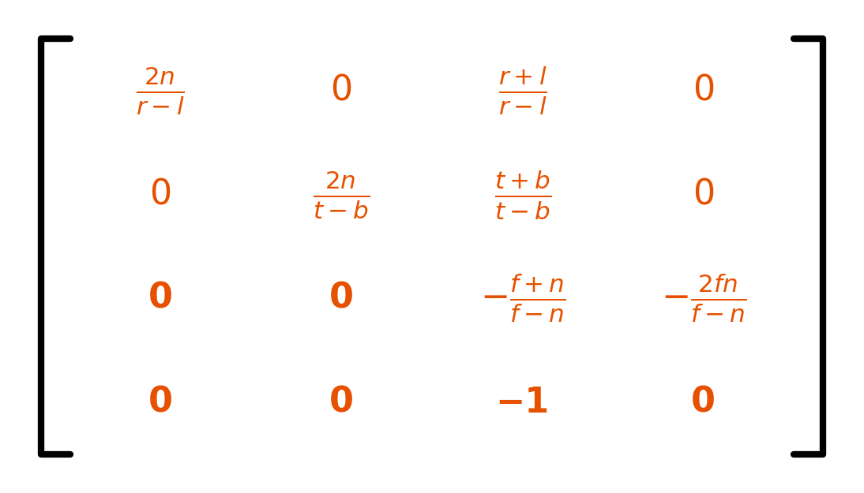
glFrustum — Full Projection Matrix
glFrustum(l, r, b, t, n, f)
Key Differences from Ortho
★
Row 4: [0,0,−1,0]
Sets w = −z, enabling the Perspective Divide step
★
Nonlinear z-depth
z maps non-linearly; near-plane gets higher precision
★
Perspective Divide
After matrix multiply: divide (x,y,z) by w to get NDC
★
Row 3 coefficients
A = −(f+n)/(f−n), B = −2fn/(f−n)

Slide 10
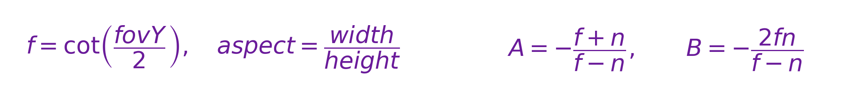
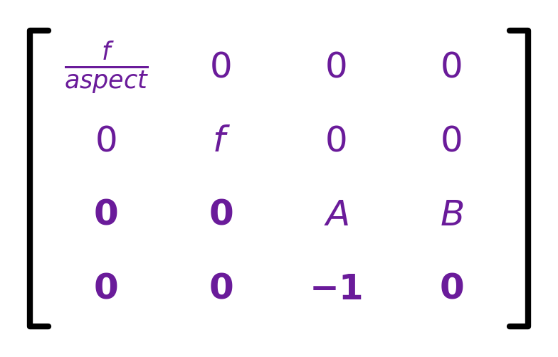
04 gluPerspective & Matrix Derivation
gluPerspective( fovY, aspect, zNear, zFar )
fovY
Vertical field-of-view angle (degrees)
aspect
Viewport width / height ratio
zNear
Distance to near clipping plane (must be > 0)
zFar
Distance to far clipping plane
Derived Parameters
Resulting Matrix

Slide 11
05 Parallel vs Perspective — Comparison
Property
Parallel Projection
Perspective Projection
Projectors
Mutually parallel
Converge at COP
Size change
Constant (distance-independent)
Smaller with distance
Depth perception
None (no distortion)
Yes (matches human eye)
Math complexity
Simple (linear transform)
Complex (nonlinear, ÷w)
View volume
Cuboid (box)
Frustum (truncated pyramid)
Depth precision
Linear distribution
Nonlinear (concentrated near)
Primary use
CAD, engineering, 2D games
3D games, VR, film CG

Slide 12


Projection in the 3D Rendering Pipeline
Model
Transform
View
Transform
Projection
Transform
Perspective
Divide
Viewport
Transform
Local coords
→ World coords
(M matrix)
World coords
→ Camera space
(V matrix)
Camera space
→ Clip space
(P matrix) ★
Clip → NDC
(÷w)
Nonlinear step
NDC
→ Screen pixels
Pixel mapping
Perspective Divide:
M (Model)
V (View)
P (Projection) ★
Position, rotation, scale of each object
Camera position & orientation (lookAt)
Applies parallel or perspective — today's core topic!

Slide 13
Real-World Applications
CAD / Engineering
3D Game Engines
Medical Imaging
VR / AR
Parallel
Perspective
Parallel
Perspective
AutoCAD, SolidWorks
Exact dimension drawing
Ortho view preserves
all proportions
Unity, Unreal Engine
Realistic depth/distance
gluPerspective camera
FoV and aspect settings
CT/MRI visualization
Accurate anatomy ratios
Axial, coronal, sagittal
ortho views
Stereoscopic rendering
Separate eye cameras
Wide FoV (90°+)
Head-tracking support

Slide 14
SUMMARY
Key Takeaways
①
Projection is the critical P step in the MVP rendering pipeline (3D → 2D)
②
Parallel: parallel projectors, size invariant, exact dimensions → CAD & engineering
③
Perspective: all rays converge at COP, distance-based foreshortening → games & VR
④
Math core: similar triangles, homogeneous coords, Perspective Divide (÷ w)
⑤
OpenGL API: glOrtho / glFrustum / gluPerspective — all produce 4×4 P matrices
Computer Graphics | Parallel & Perspective Projections

